Slide 1
Block and Port Level Protocols
XUP

Slide 2
Objectives
After completing this module, you will be able to:
List the types of IO abstracted in Vitis HLS
List various basic and optional IO ports handled in Vitis HLS
State how a design can be synthesized as combinatorial and sequential
Distinguish between block-level and port-level IO protocols
State how pointer interfaces are implemented

Slide 3
Objectives
After completing this module, you will be able to:
List the types of IO abstracted in Vitis HLS
List various basic and optional IO ports handled in Vitis HLS
State how a design can be synthesized as combinatorial and sequential
Distinguish between block-level and port-level IO protocols
State how pointer interfaces are implemented

Slide 4
Outline
Introduction
Block Level Protocols
Port Level Protocols
Summary

Slide 5
The Key Attributes of C code : IO
Functions: All code is made up of functions which represent the design hierarchy: the same in hardware
Code
void fir (
data_t *y,
coef_t c[4],
data_t x
) {
static data_t shift_reg[4];
acc_t acc;
int i;
acc=0;
loop: for (i=3;i>=0;i--) {
if (i==0) {
acc+=x*c[0];
shift_reg[0]=x;
} else {
shift_reg[i]=shift_reg[i-1];
acc+=shift_reg[i] * c[i];
}
}
*y=acc>>2;
}
Input & Outputs: The arguments of the top-level function must be transformed to hardware interfaces with an IO protocol
Types: All variables are of a defined type. The type can influence the area and performance
Loops: Functions typically contain loops. How these are handled can have an impact on area and performance.
Arrays: Arrays are used often in C code. They can impact the device area and become performance bottlenecks.
Operators: Operators in the C code may require sharing to control area or be assigned to specific hardware implementations to meet performance

Slide 6
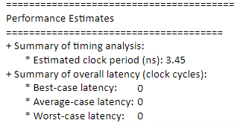
Example 101 : Combinational Design
Simple Adder Example
Output is the sum of 3 inputs
Synthesized with 100 ns clock
All adders can fit in one clock cycle
Combinational design
The function return becomes RTL port ap_return
No handshakes are required or created in this example
#include "adders.h"
int adders(int in1, int in2, int in3) {
int sum;
sum = in1 + in2 + in3;
return sum;
}
in1
adders
ap_return
In2
In3

Slide 7
Example 102: Sequential Design
The same adder design is now synthesized with a 3ns clock
The design now takes more than 1 cycle to complete
Vitis HLS creates a sequential design with the default port types
By Default ..
Block level handshake signals are added to the design
ap_start: when to start
ap_done: when the design has completed the operation
ap_idle: when the design is idle
#include "adders.h"
int adders(int in1, int in2, int in3) {
int sum;
sum = in1 + in2 + in3;
return sum;
}
in1
adders
In2
ap_return
Synthesis
In3
ap_done
ap_start
ap_idle

Slide 8
Example 102: Sequential Design
The same adder design is now synthesized with a 3ns clock
The design now takes more than 1 cycle to complete
Vitis HLS creates a sequential design with the default port types
By Default ..
Block level handshake signals are added to the design
ap_start: when to start
ap_done: when the design has completed the operation
ap_idle: when the design is idle
#include "adders.h"
int adders(int in1, int in2, int in3) {
int sum;
sum = in1 + in2 + in3;
return sum;
}
in1
adders
In2
ap_return
Synthesis
In3
ap_done
ap_start
ap_idle

Slide 9
Vitis HLS IO Options
Vitis HLS has four types of IO
Data ports created by the original top-level C function arguments
IO protocol signals added at the Block-Level
IO protocol signals added at the Port-Level
IO protocol signals added externally as IP Interfaces
Data Ports
These are the function arguments/parameters
Block-Level Interfaces (optional)
An interface protocol which is added at the block level
Controls the addition of block level control ports: start, idle, done, and ready
Port-Level interfaces (optional)
IO interface protocols added to the individual function arguments
IP interfaces (optional)
Added as external adapters when exported as an IP

Slide 10
Vitis HLS IO Options
Vitis HLS has four types of IO
Data ports created by the original top-level C function arguments
IO protocol signals added at the Block-Level
IO protocol signals added at the Port-Level
IO protocol signals added externally as IP Interfaces
Data Ports
These are the function arguments/parameters
Block-Level Interfaces (optional)
An interface protocol which is added at the block level
Controls the addition of block level control ports: start, idle, done, and ready
Port-Level interfaces (optional)
IO interface protocols added to the individual function arguments
IP interfaces (optional)
Added as external adapters when exported as an IP
22- 10

Slide 11
Vitis HLS Basic Ports
Clock added to all sequential RTL blocks
One clock per function/block
SystemC designs may have a unique clock for each CTHREAD
Reset added to all sequential RTL blocks
Only the FSM and any variables initialized in the C are reset by default
Reset and polarity options are controlled via the RTL Configuration
Solutions/Solution Settings...
Optional Clock Enable
An optional clock enable can be added via the sequential RTL (config_interface) configuration
When de-asserted it will cause the block to “freeze”
All connected blocks are assumed to be using the same CE
When the IO protocol of this block freezes, it is expected other blocks do the same
Else a valid output may be read multiple times
Adder Example
#include "adders.h"
int adders(int in1, int in2, int *sum) {
int temp;
*sum = in1 + in2 + *sum;
temp = in1 + in2;
return temp;
}
Synthesis
adders
ap_clk
ap_rst
ap_ce
22- 11

Slide 12
Vitis HLS Optional IO : Function Arguments
Function Arguments
Synthesized into input and/or output data ports
Function Return
Any return is synthesized into an output port called ap_return
Pointers (& C++ References)
Can be read from and written to
Separate input and output ports for pointer reads and writes
Arrays (not shown here)
Like pointers can be synthesized into read and/or write ports
Adder Example
#include "adders.h"
int adders(int in1, int in2, int *sum) {
int temp;
*sum = in1 + in2 + *sum;
temp = in1 + in2;
return temp;
}
Synthesis
adders
adders
in1
ap_return
in2
sum_datain
sum_dataout
ap_clk
ap_rst

Slide 13
Vitis HLS Optional IO : Function Arguments
Function Arguments
Synthesized into input and/or output data ports
Function Return
Any return is synthesized into an output port called ap_return
Pointers (& C++ References)
Can be read from and written to
Separate input and output ports for pointer reads and writes
Arrays (not shown here)
Like pointers can be synthesized into read and/or write ports
Adder Example
#include "adders.h"
int adders(int in1, int in2, int *sum) {
int temp;
*sum = in1 + in2 + *sum;
temp = in1 + in2;
return temp;
}
Synthesis
adders
adders
in1
ap_return
in2
sum_datain
sum_dataout
ap_clk
ap_rst
22- 13

Slide 14
Vitis HLS Optional IO : Block Level Protocol
Block Level Protocol
An IO protocol added at the RTL block level
Controls and indicates the operational status of the block
Block Operation Control
Controls when the RTL block starts execution (ap_start)
Indicates if the RTL block is idle (ap_idle) or has completed (ap_done)
Complete and function return
The ap_done signal also indicates when any function return is valid
Ready (not shown here)
If the function is pipelined an additional ready signal (ap_ready) is added
Indicates a new sample can be supplied before done is asserted
Adder Example
#include "adders.h"
int adders(int in1, int in2, int *sum) {
int temp;
*sum = in1 + in2 + *sum;
temp = in1 + in2;
return temp;
}
Synthesis
adders
ap_done
ap_start
ap_idle
in1
ap_return
in2
sum_datain
sum_dataout
ap_clk
ap_rst

Slide 15
Vitis HLS Optional IO : Block Level Protocol
Block Level Protocol
An IO protocol added at the RTL block level
Controls and indicates the operational status of the block
Block Operation Control
Controls when the RTL block starts execution (ap_start)
Indicates if the RTL block is idle (ap_idle) or has completed (ap_done)
Complete and function return
The ap_done signal also indicates when any function return is valid
Ready (not shown here)
If the function is pipelined an additional ready signal (ap_ready) is added
Indicates a new sample can be supplied before done is asserted
Adder Example
#include "adders.h"
int adders(int in1, int in2, int *sum) {
int temp;
*sum = in1 + in2 + *sum;
temp = in1 + in2;
return temp;
}
Synthesis
adders
ap_done
ap_start
ap_idle
in1
ap_return
in2
sum_datain
sum_dataout
ap_clk
ap_rst
22- 15

Slide 16
Vitis HLS Optional IO : Port-Level IO Protocols
Port IO Protocols
An IO protocol added at the port level
Sequences the data to/from the data port
Interface Synthesis
The design is automatically synthesized to account for IO signals (enables, acknowledges etc.)
Select from a pre-defined list
The IO protocol for each port can be selected from a list
Allows the user to easily connect to surrounding blocks
Non-standard Interfaces
Supported in C++ using an arbitrary protocol definition
Adder Example
#include "adders.h"
int adders(int in1, int in2, int *sum) {
int temp;
*sum = in1 + in2 + *sum;
temp = in1 + in2;
return temp;
}
Synthesis
adders
adders
ap_done
ap_start
ap_idle
ap_return
in1
in1_ap_ack
in1_ap_vld
in2
in2_read
in2_empty_n
sum_datain
sum_dataout
sum_req_full_n
sum_req_write
sum_rsp_empty_n
sum_rsp_read
ap_clk
sum_req_din
ap_rst
sum_address
sum_size

Slide 17
Vitis HLS Optional IO : Port-Level IO Protocols
Port IO Protocols
An IO protocol added at the port level
Sequences the data to/from the data port
Interface Synthesis
The design is automatically synthesized to account for IO signals (enables, acknowledges etc.)
Select from a pre-defined list
The IO protocol for each port can be selected from a list
Allows the user to easily connect to surrounding blocks
Non-standard Interfaces
Supported in C/C++ using an arbitrary protocol definition
Supported natively in SystemC
Adder Example
#include "adders.h"
int adders(int in1, int in2, int *sum) {
int temp;
*sum = in1 + in2 + *sum;
temp = in1 + in2;
return temp;
}
Synthesis
adders
adders
ap_done
ap_start
ap_idle
ap_return
in1
in1_ap_ack
in1_ap_vld
in2
in2_read
in2_empty_n
sum_datain
sum_dataout
sum_req_full_n
sum_req_write
sum_rsp_empty_n
sum_rsp_read
ap_clk
sum_req_din
ap_rst
sum_address
sum_size
22- 17

Slide 18
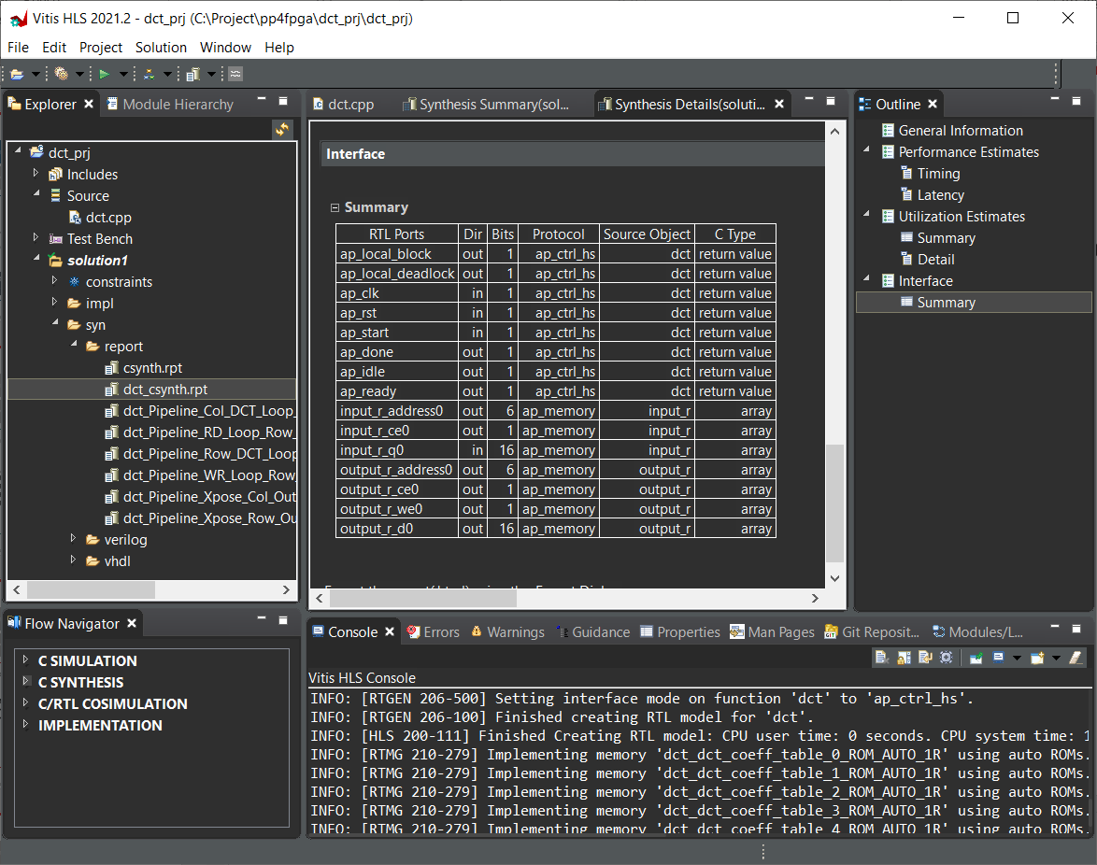
Vitis HLS Interfaces Summary
Where do you find the summary?
In the Synthesis report
Ports
Sizes and Direction
Interface Summary Section (at the end)
The same pathname as this from the project directory

Slide 19
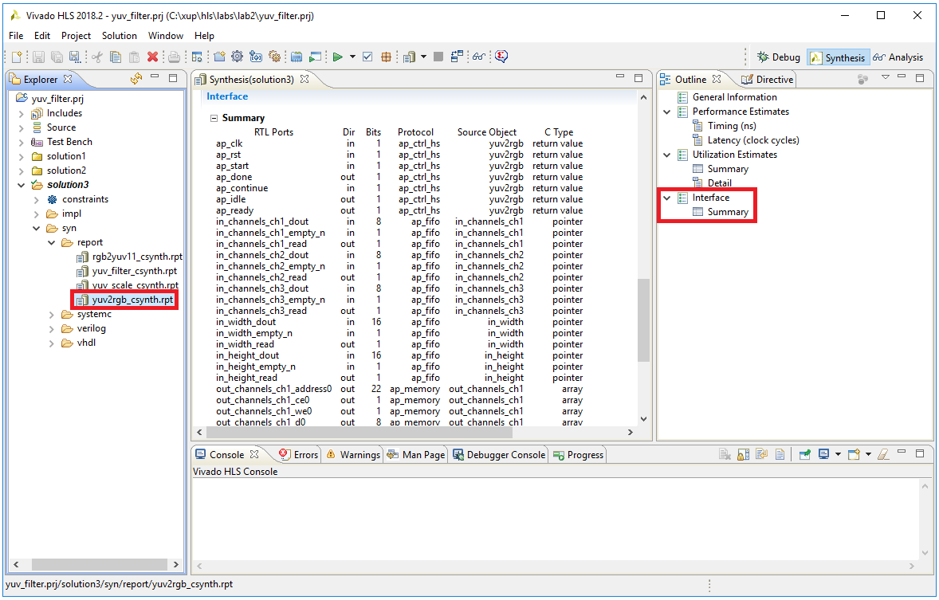
Vitis HLS Interfaces Summary
Where do you find the summary?
In the Synthesis report
Ports
Sizes and Direction
Interface Summary Section (at the end)
The same pathname as this from the project directory
22- 19

Slide 20
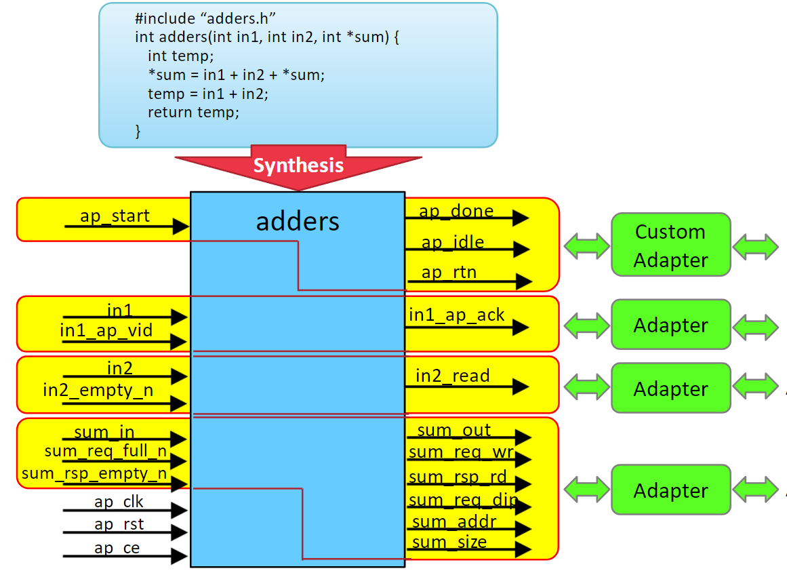
Vitis HLS Optional IO : IP Adapters
Adder Example
Added when the IP block is exported
Available in the IP directory
“ip”, “sysgen”
AXI Slave
AXI Stream
AXI Master

Slide 21
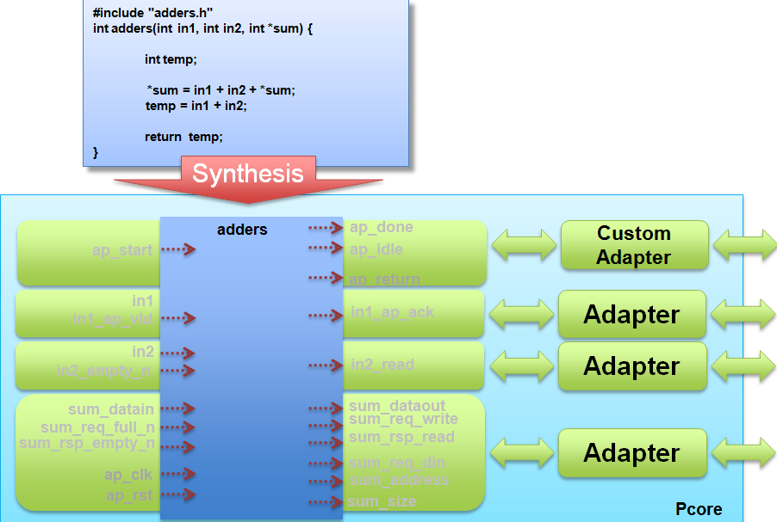
Vitis HLS Optional IO : IP Adapters
Adder Example
Added when the IP block is exported
Available in the IP directory
“ip”, “sysgen”
AXI Slave
AXI Stream
AXI Master
AXI4LiteS
AXI4
AXI4Stream

Slide 22
Block Level Protocols

Slide 23
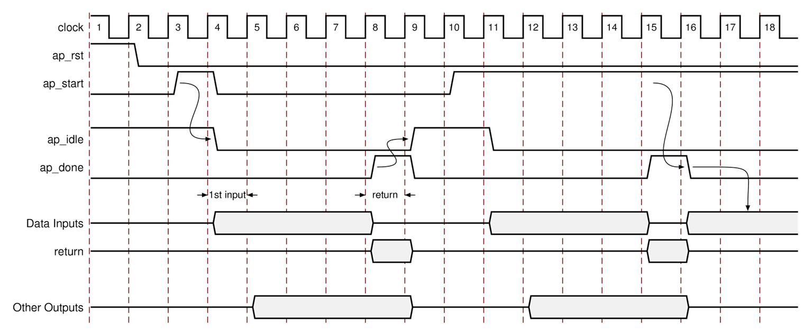
AP_START: Single Cycle
The block will wait for ap_start before it begins operation
Output ap_idle goes low when ap_start is sampled high
Output ap_done goes high on the final cycle
Idle goes high one cycle after done
The block waits for next start
Input Data
Can be applied when ap_idle goes low
The first read is performed 1 clock cycle after idle goes low
Input reads can occur in any cycle up until the last cycle
Output Data
Any function return is valid when ap_done is asserted high
Other outputs may output their data at any time after the first read
The output can only be guaranteed to be valid with ap_done if it is registered
It is recommended to use a port level IO protocol for other outputs

Slide 24
AP_START: Constant High
If start is high when done is asserted, the design will not enter the idle state
Since start is high, idle stays low
The block starts to execute the next transaction immediately
Input and Output data operations
As before
The key difference here is that the design is never idle
The next data read is performed immediately

Slide 25
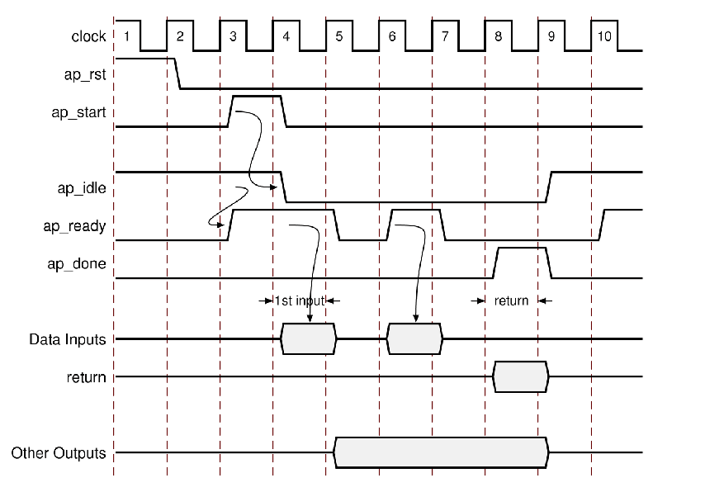
Pipelined Designs
After reset, ap_ready goes high if idle is high
Start applied : Idle goes low, apply first data
Inputs will be read when ap_ready is high and idle is low
Output ap_done goes high on the final cycle
Idle goes high one cycle after done
The block waits for next start
Input Data
Will be read when ap_ready is high and ap_idle is low
Indicates the design is ready for data
Signal ap_ready will change at the rate of the II
Output Data
As before, function return is valid when ap_done is asserted high
Other outputs may output their data at any time after the first read
It is recommended to use a port level IO protocol for other outputs
This example shows an II of 2

Slide 26
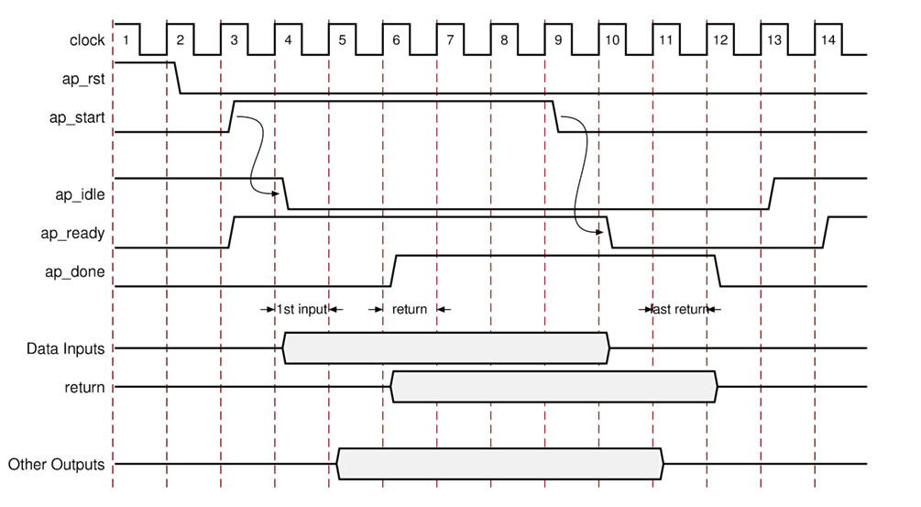
Pipelined Designs: II = 1
Will start with ap_start
Will keep reading input data since II = 1
After the first output, ap_done will remain high
If ap_start goes is sampled low, ap_ready will go low immediately
Input Data when II=1
It can be expected that ap_ready remains high and data is continuously read
The design will only stop processing when ap_start is de-asserted
Output Data when II=1
After the first output, ap_done will remain high while there are samples to process
Assuming there is no data decimation (output rate = input rate)

Slide 27
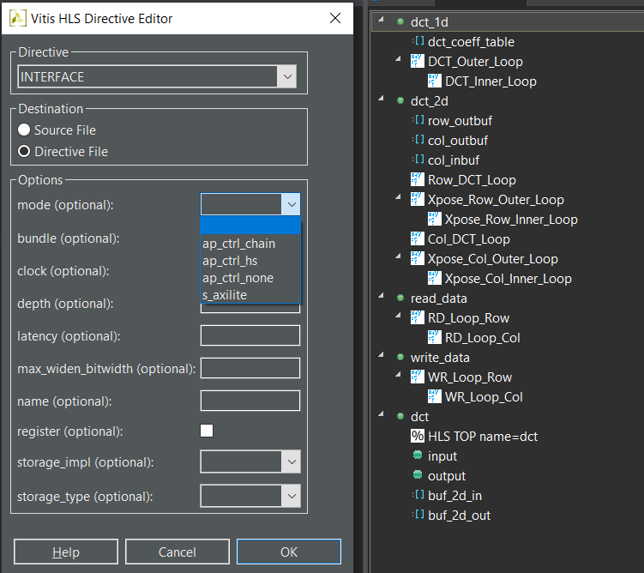
Disabling Block Level Handshakes
Block Level Handshakes can be disabled
Select the function in the directives tab, right-click
Select Interface & then ap_ctrl_none for no block level handshakes
Select Interface & then ap_ctrl_hs to re-apply the default
Requirement: Manually verify the RTL
Without block level handshakes autosim cannot verify the design
Will only work in simple combo and II=1 cases
Handshakes are required to know when to sample output signals
# Tcl commands
set_directive_interface -mode ap_ctrl_none “dct“
# Default is on
# set_directive_interface -mode ap_ctrl_hs “dct“
It is recommended to leave the default and use Block Level Handshakes

Slide 28
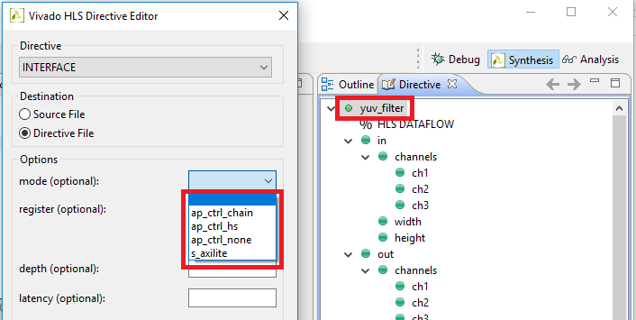
Disabling Block Level Handshakes
Block Level Handshakes can be disabled
Select the function in the directives tab, right-click
Select Interface & then ap_ctrl_none for no block level handshakes
Select Interface & then ap_ctrl_hs to re-apply the default
Requirement: Manually verify the RTL
Without block level handshakes autosim cannot verify the design
Will only work in simple combo and II=1 cases
Handshakes are required to know when to sample output signals
# Tcl commands
set_directive_interface -mode ap_ctrl_none “dct“
# Default is on
# set_directive_interface -mode ap_ctrl_hs “dct“
It is recommended to leave the default and use Block Level Handshakes

Slide 29
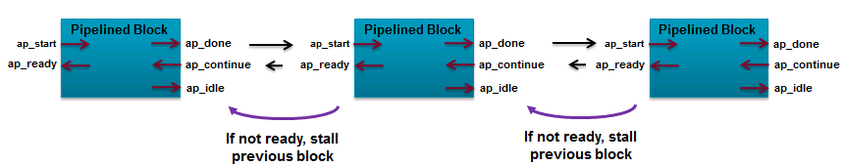
AP_CTRL_CHAIN
Protocol to support pipeline chains: ap_ctrl_chain
Similar to ap_ctrl_hs but with additional signal ap_continue
Allows blocks to be easily chained in a pipelined manner
ap_ctrl_chain protocol provides back-pressure in systems

Slide 30
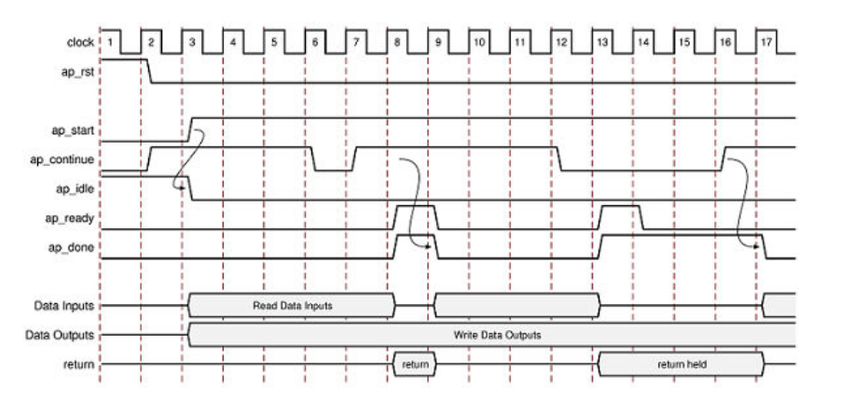
AP_CTRL_CHAIN
Asserting the ap_continue signal Low informs the design that the downstream block that consumes the data is not ready to accept new data
When ap_continue is asserted Low, the design stalls when it reaches the final state of the current transaction: the output data is presented on the interface, the ap_done signal can be asserted High and the design remains in this state until ap_continue is asserted High

Slide 31
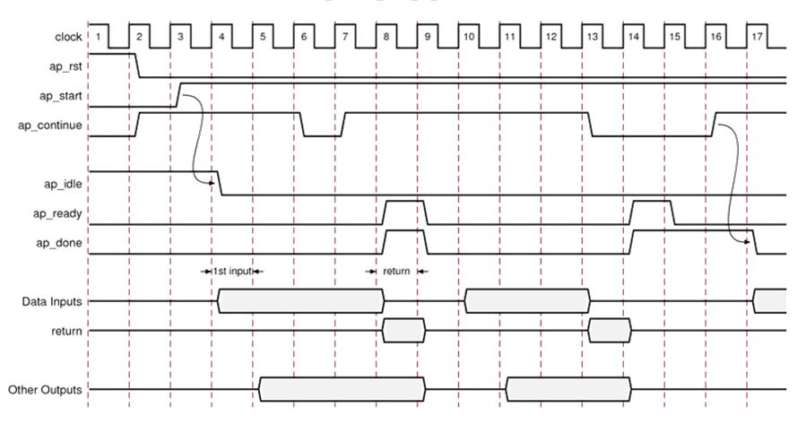
AP_CTRL_CHAIN
Asserting the ap_continue signal Low informs the design that the downstream block that consumes the data is not ready to accept new data
When ap_continue is asserted Low, the design stalls when it reaches the final state of the current transaction: the output data is presented on the interface, the ap_done signal can be asserted High and the design remains in this state until ap_continue is asserted High

Slide 32
Port Level Protocols

Slide 33
Port Level IO protocols
We’ve seen how the function return is validated
The block level output signal ap_done goes high to indicate the function return is valid
This allows downstream blocks to correctly sample the output port
For other outputs, Port Level IO protocols can be added
Allowing upstream and downstream blocks to synchronize with the other data ports
The type of protocol depends on the type of C port
Pass-by-value scalar
Pass-by-reference pointers
Pass-by-reference arrays
in1
adders
ap_return
data
downstream
In2
sum
enable
In3
ap_done
ap_start
ap_idle
The starting point is the type of argument used by the C function

Slide 34
Port Level IO protocols
We’ve seen how the function return is validated
The block level output signal ap_done goes high to indicate the function return is valid
This allows downstream blocks to correctly sample the output port
For other outputs, Port Level IO protocols can be added
Allowing upstream and downstream blocks to synchronize with the other data ports
The type of protocol depends on the type of C port
Pass-by-value scalar
Pass-by-reference pointers (& references in C++)
Pass-by-reference arrays
in1
adders
ap_return
data
downstream
In2
sum
enable
In3
ap_done
ap_start
ap_idle
The starting point is the type of argument used by the C function

Slide 35
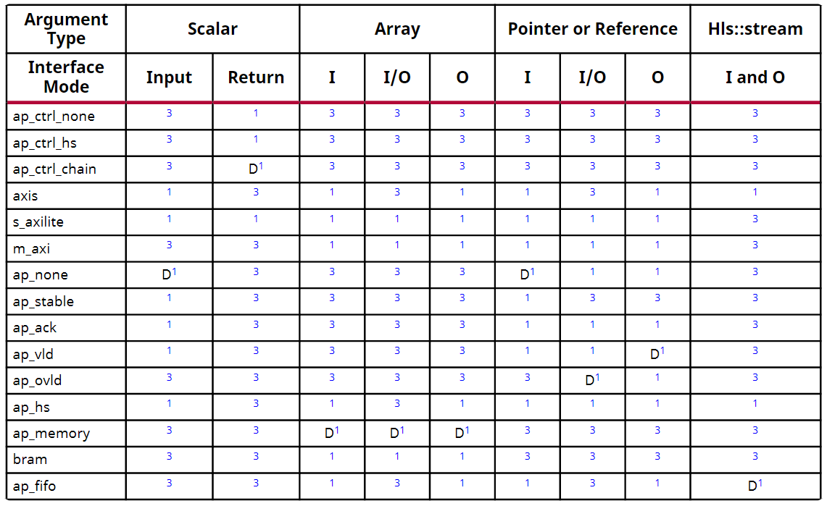
Let’s Look at an Example
“Sum” is a pointer which is read and written to : an Inout
#include "adders.h"
int adders(int in1, int in2, int *sum) {
int temp;
*sum = in1 + in2 + *sum;
temp = in1 + in2;
return temp;
}
The port for “Sum” can be any of these interface types
The default for port for “Sum” will be type ap_ovld
Key:
I : input
IO : inout
O : output
D : Default Interface

Slide 36
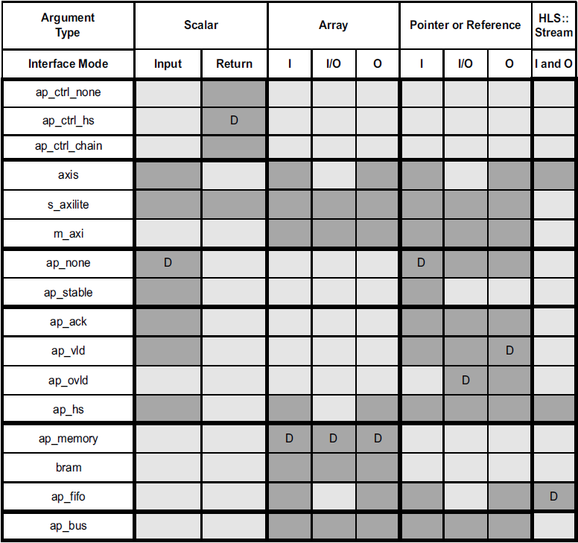
Let’s Look at an Example
“Sum” is a pointer which is read and written to : an Inout
#include "adders.h"
int adders(int in1, int in2, int *sum) {
int temp;
*sum = in1 + in2 + *sum;
temp = in1 + in2;
return temp;
}
The port for “Sum” can be any of these interface types
The default for port for “Sum” will be type ap_ovld
Key:
I : input
IO : inout
O : output
D : Default Interface

Slide 37

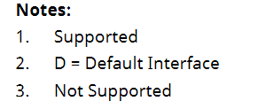
Interface Types
Multiple interface protocols
Every combination of C argument and port protocol is not supported
It may require a code modification to implement a specific IO protocol
Block Level Protocol
AXI4 Interfaces
No IO Protocol
Wire handshake
protocols
Block level protocols can be applied to the return port - but the port can be omitted and just the function name specified
Memory protocols
: RAM
: FIFO
Bus protocols
Notes:
Ug1391：paragma INTERFACE no longer supports the ap_bus mode that was supported in Vivado HLS. You should use the m_axi interface instead

Slide 38
Interface Types
Multiple interface protocols
Every combination of C argument and port protocol is not supported
It may require a code modification to implement a specific IO protocol
Block Level Protocol
AXI4 Interfaces
No IO Protocol
Wire handshake
protocols
Block level protocols can be applied to the return port - but the port can be omitted and just the function name specified
Memory protocols
: RAM
: FIFO
Bus protocols
Notes:
Ug1391：paragma INTERFACE no longer supports the ap_bus mode that was supported in Vivado HLS. You should use the m_axi interface instead

Slide 39
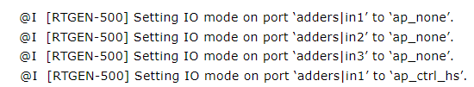
Default IO Protocols
The default port protocols
Inputs: ap_none
Outputs: ap_vld
Inout: ap_ovld
In port gets ap_none
Out port gets ap_vld
Arrays: ap_memory
All shown as the default (D) on previous slide
Result of the default protocols
No protocol for input ports
They should be held stable for the entire transaction
There is no way to know when the input will be read
Output writes have an accompanying output valid signal which can be used to validate them
Arrays will default to RAM interfaces (2-port RAM is the default RAM)
The VITIS HLS shell/console always shows the results of interface synthesis

Slide 40
Default IO Protocols
The default port protocols
Inputs: ap_none
Outputs: ap_vld
Inout: ap_ovld
In port gets ap_none
Out port gets ap_vld
Arrays: ap_memory
All shown as the default (D) on previous slide
Result of the default protocols
No protocol for input ports
They should be held stable for the entire transaction
There is no way to know when the input will be read
Output writes have an accompanying output valid signal which can be used to validate them
Arrays will default to RAM interfaces (2-port RAM is the default RAM)
The VITIS HLS shell/console always shows the results of interface synthesis
22- 40

Slide 41
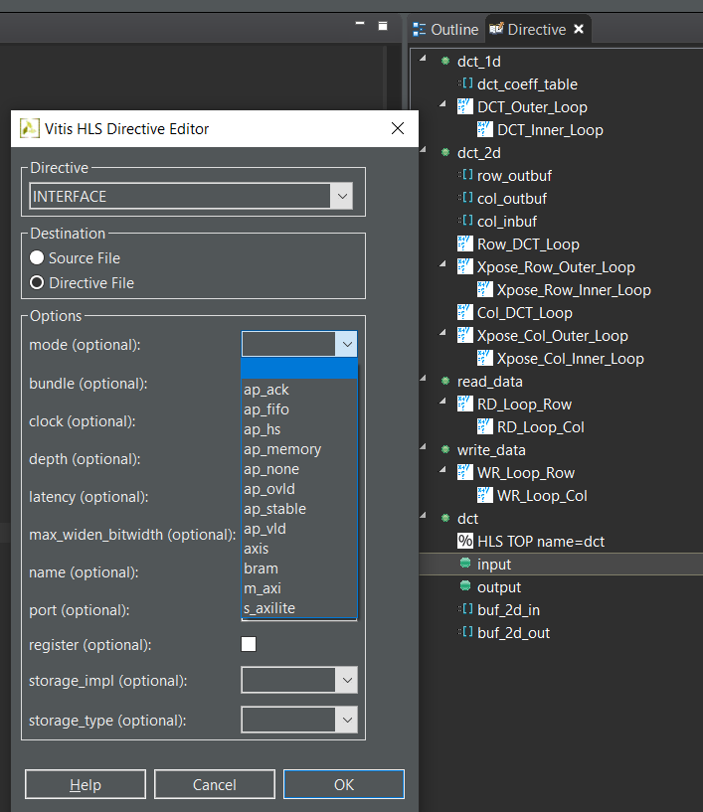
Specifying IO Protocols
Select the port in the Directives pane to specify a protocol
Select the port
Right-click and choose Interface
Select the protocol from the drop-down menu
Or apply using Tcl or Pragma

Slide 42
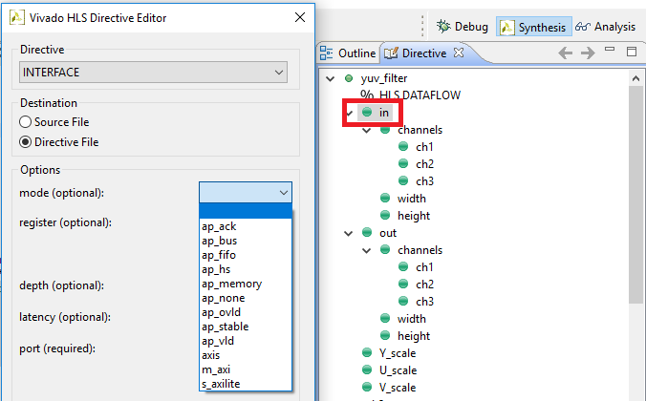
Specifying IO Protocols
Select the port in the Directives pane to specify a protocol
Select the port
Right-click and choose Interface
Select the protocol from the drop-down menu
Or apply using Tcl or Pragma

Slide 43
Interface Types
Multiple interface protocols
Every combination of C argument and port protocol is not supported
It may require a code modification to implement a specific IO protocol
Block Level Protocol
AXI4 Interfaces
No IO Protocol
Wire handshake
protocols
Block level protocols can be applied to the return port - but the port can be omitted and just the function name specified
Memory protocols
: RAM
: FIFO

Slide 44
Interface Types
Multiple interface protocols
Every combination of C argument and port protocol is not supported
It may require a code modification to implement a specific IO protocol
Block Level Protocol
AXI4 Interfaces
No IO Protocol
Wire handshake protocols
Memory protocols : RAM
: FIFO
Block level protocols can be applied to the return port - but the port can be omitted and just the function name specified
22- 44
Bus protocols

Slide 45
No IO Protocol
AP_NONE: The default protocol for scalar input ports
Protocol ap_none means that no additional protocol signals are added
The port will be implemented as just a data port
Other ports can be specified as ap_none
Except arrays which must be a RAM or FIFO interface
AP_STABLE: An ap_none with fanout benefits
The ap_stable type informs High-Level Synthesis that the data applied to this port remains stable during normal operation, but is not a constant value that could be optimized, and the port is not required to be registered
Typically used for ports that provides configuration data - data that can change but remains stable during normal operation (configuration data is typically only changed during or before a reset)

Slide 46
No IO Protocol
AP_NONE: The default protocol for scalar input ports
Protocol ap_none means that no additional protocol signals are added
The port will be implemented as just a data port
Other ports can be specified as ap_none
Except arrays which must be a RAM or FIFO interface
AP_STABLE: An ap_none with fanout benefits
The ap_stable type informs High-Level Synthesis that the data applied to this port remains stable during normal operation, but is not a constant value that could be optimized, and the port is not required to be registered
Typically used for ports that provides configuration data - data that can change but remains stable during normal operation (configuration data is typically only changed during or before a reset)

Slide 47
Interface Types
Multiple interface protocols
Every combination of C argument and port protocol is not supported
It may require a code modification to implement a specific IO protocol
Block Level Protocol
AXI4 Interfaces
No IO Protocol
Wire handshake
protocols
Block level protocols can be applied to the return port - but the port can be omitted and just the function name specified
Memory protocols
: RAM
: FIFO

Slide 48
Interface Types
Multiple interface protocols
Every combination of C argument and port protocol is not supported
It may require a code modification to implement a specific IO protocol
Block Level Protocol
AXI4 Interfaces
No IO Protocol
Wire handshake protocols
Memory protocols : RAM
: FIFO
Block level protocols can be applied to the return port - but the port can be omitted and just the function name specified
22- 48
Bus protocols

Slide 49
Wire Protocols
The wire protocols add a valid and/or acknowledge port to each data port
The wire protocols are all derivatives of protocol ap_hs
ap_ack: add an additional acknowledge port
ap_vld: add an additional valid port
ap_ovld: add an additional valid port to an output
ap_hs: adds both
Output control signals are used to inform other blocks
Data has been read at the input by this block (ack)
Data is valid at the output (vld)
The other block must accept the control signal (this block will continue)
Input control signals are used to inform this block
The output data has been read by the consumer (ack)
The input from the producer is valid (vld)
This block will stall while waiting for the input controls

Slide 50
Wire Protocols: Ports Generated
The wire protocols are all derivatives of protocol ap_hs
Inputs
Arguments which are only read
The valid is input port indicating when to read
Acknowledge is an output indicating it was read
Outputs
Arguments which are only written to
Valid is an output indicating data is ready
Acknowledge is an input indicating it was read
Inouts
Arguments which are read from and written to
These are split into separate in and out ports
Each half has handshakes as per Input and Output
ap_hs is compatible with AXI-Stream
foo
in1
in1_vld
in1_ack
foo
out1
out1_ack
out1_vld
adders
inout1_i
Inout1_i_vld
inout1_i_ack
inout1_o
Inout1_o_ack
inout1_o_vld

Slide 51
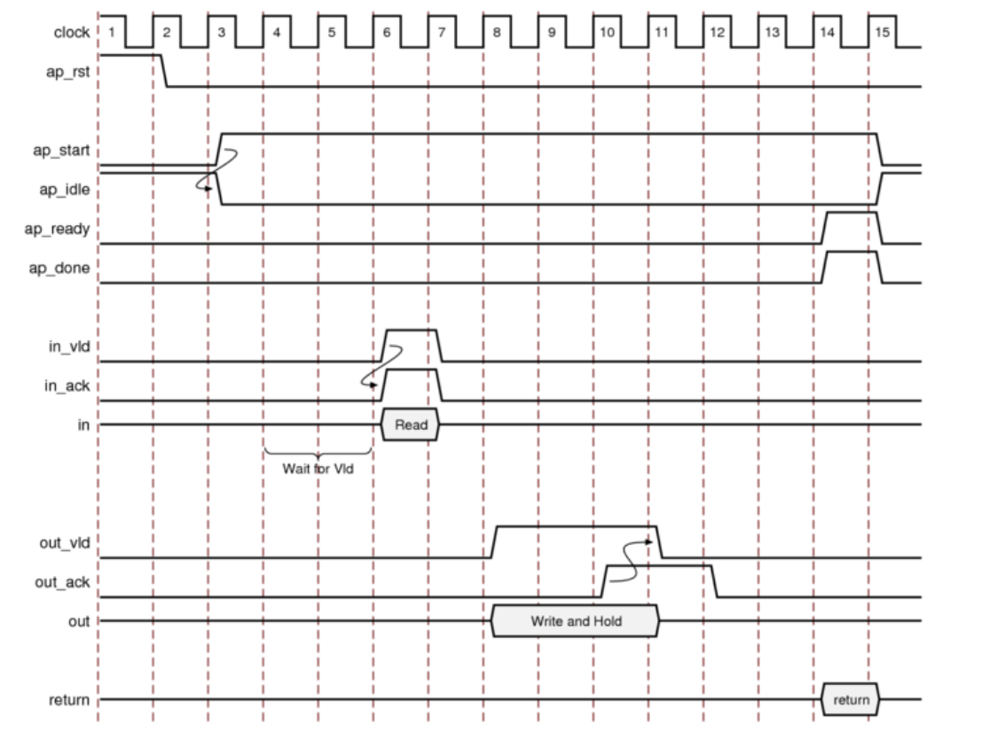
Handshake IO Protocol
After start is applied, the block begins normal operation.
The RTL will stall (wait) until the input valid is asserted
If there is more than one input valid, each can stall the RTL
It will acknowledge on the same cycle it reads the data (reads on next clock edge)
An output valid is asserted when the port has data
The RTL will stall (hold the data and wait) until an input acknowledge is received
Done will be asserted when the function is complete

Slide 52
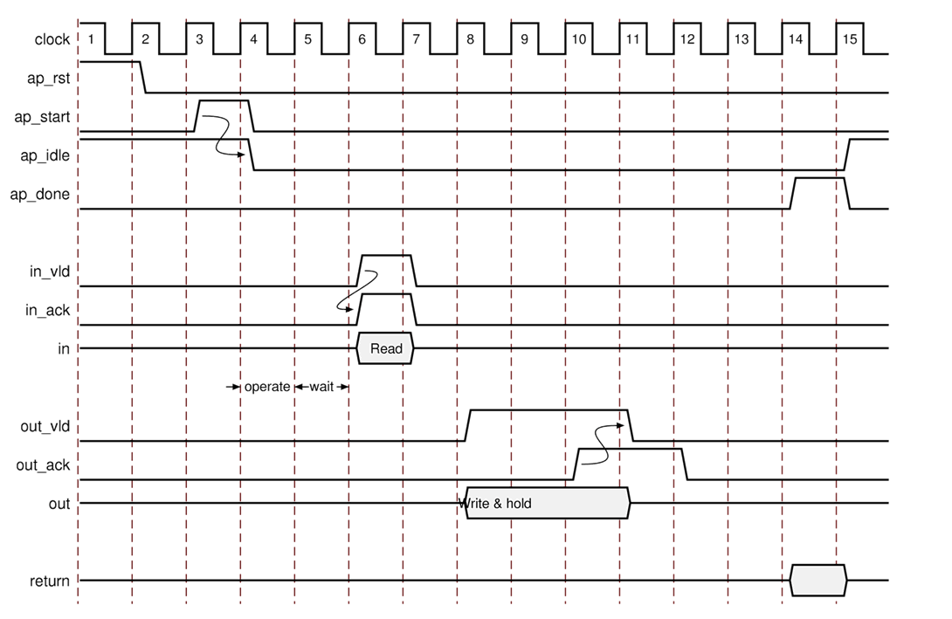
Handshake IO Protocol
After start, idle goes low and the RTL operates until a read is required
The RTL will stall (wait) until the input valid is asserted
If there is more than one input valid, each can stall the RTL
It will acknowledge on the same cycle it reads the data (reads on next clock edge)
An output valid is asserted when the port has data
The RTL will stall (hold the data and wait) until an input acknowledge is received
Done will be asserted when the function is complete
22- 52

Slide 53
Other Handshake Protocols
The other wire protocols are derivatives of ap_hs in behavior
Some subtleties are worth discussing when the full two-way handshake is not used
Using the Valid protocols (ap_vld, ap_ovld)
Outputs: Without an associated input acknowledge it is a requirement that the consumer takes the data when the output valid is asserted
Protocol ap_ovld only applies to output ports (is ignored on inputs)
Inputs: No particular issue.
Without an associated output acknowledge, the producer does not know when the data has been read (but the done signal can be used to update values)
Using the Acknowledge Protocol (ap_ack)
Outputs: Without an associated output valid the consumer will not know when valid data is ready but the design will stall until it receives an acknowledge (Dangerous: Lock up potential)
Inputs: Without an associated input valid, the design will simply read when it is ready and acknowledge that fact.

Slide 54
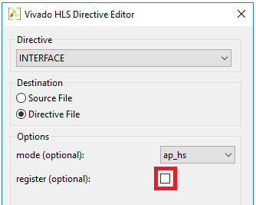
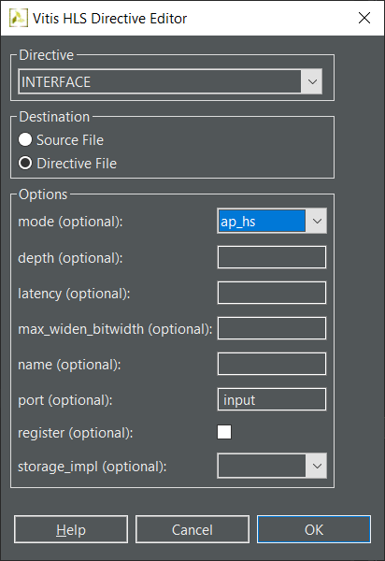
Registering IO Reads and Writes
Vitis HLS does not register Input and Outputs by default
It will chain operations to minimize latency
The inputs will be read when the design requires them
The outputs will be written as soon as they are available
Inputs and outputs can be registered
Inputs will be registered in the first cycle
Input pointers and partitioned arrays will be registered when they are required
Outputs will be registered and held until the next write operation
Which for scalars will be the next transaction (can’t write twice to the same port) unless the block is pipelined
clk
in1
X1
in2
X2
in3
X3
+
FD
+
sum
sum
sum_vld

Slide 55
Registering IO Reads and Writes
Vitis HLS does not register Input and Outputs by default
It will chain operations to minimize latency
The inputs will be read when the design requires them
The outputs will be written as soon as they are available
Inputs and outputs can be registered
Inputs will be registered in the first cycle
Input pointers and partitioned arrays will be registered when they are required
Outputs will be registered and held until the next write operation
Which for scalars will be the next transaction (can’t write twice to the same port) unless the block is pipelined
clk
in1
X1
in2
X2
in3
X3
+
FD
+
sum
sum
sum_vld
22- 55

Slide 56
Interface Types
Multiple interface protocols
Every combination of C argument and port protocol is not supported
It may require a code modification to implement a specific IO protocol
Block Level Protocol
AXI4 Interfaces
No IO Protocol
Wire handshake
protocols
Block level protocols can be applied to the return port - but the port can be omitted and just the function name specified
Memory protocols
: RAM
: FIFO

Slide 57
Interface Types
Multiple interface protocols
Every combination of C argument and port protocol is not supported
It may require a code modification to implement a specific IO protocol
Block Level Protocol
AXI4 Interfaces
No IO Protocol
Wire handshake protocols
Memory protocols : RAM
: FIFO
Block level protocols can be applied to the return port - but the port can be omitted and just the function name specified
22- 57
Bus protocols

Slide 58
Memory IO Protocols
Memory protocols can be inferred from array and pointer arguments
Array arguments can be synthesized to RAM or FIFO ports
When FIFOs specified on array ports, the ports must be read-only or write-only
Pointer (and References in C++) can be synthesized to FIFO ports
RAM ports
Support arbitrary/random accesses
Specify the array targets using the BIND_STORAGE pragma for ap_memory interface
If no target is specified, Vitis HLS determines whether to use a single or dual-port RAM interface
Requires two cycles read access: generate address, read data
Pipelining can reduce this overhead by overlapping generation with reading
FIFO ports
Require read and writes to be sequential/streaming
Always uses a standard FIFO (single-port) model
Single cycle for both reads and writes

Slide 59
Memory IO Protocols
Memory protocols can be inferred from array and pointer arguments
Array arguments can be synthesized to RAM or FIFO ports
When FIFOs specified on array ports, the ports must be read-only or write-only
Pointer (and References in C++) can be synthesized to FIFO ports
RAM ports
Support arbitrary/random accesses
Specify the array targets using the BIND_STORAGE pragma for ap_memory interface
If no target is specified, Vitis HLS determines whether to use a single or dual-port RAM interface
May be implemented with Dual-Port RAMs to increase the bandwidth
The default is a Dual-Port RAM interface
Requires two cycles read access: generate address, read data
Pipelining can reduce this overhead by overlapping generation with reading
FIFO ports
Require read and writes to be sequential/streaming
Always uses a standard FIFO (single-port) model
Single cycle for both reads and writes
22- 59

Slide 60
Memory IO Protocols: Ports Generated
RAM Ports
Created by protocol ap_memory
Given an array specified on the interface
Ports are generated for data, address & control
Example shows a single port RAM
Vits will automatically implement a dual-port interface to increase the bandwidth if it will reduce the II(initiation interval)
Using BIND_STORAGE pragma to specify the array targets
If not, Vitis HLS determines whether to use a single or dual port RAM interface
FIFO Ports
Created by protocol ap_fifo
Can be used on arrays, pointers and references
Standard Read/Write, Full/Empty ports generated
Arrays: must use separate arrays for read and write
Pointers/References: split into In and Out ports
#include "ram.h"
void ram (int d[DEPTH], …) {
…
}
d_q0
ram
d_d0
d_address0
d_we0
d_ce0
#include "fifo.h"
void fifo (int d_o[DEPTH],
int d_i[DEPTH]) {
…
}
d_i_dout
fifo
d_o_din
d_o_full_n
d_o_write
d_i_empty_n
d_i_read
Notes:
Pragma RESOURCE is replaced by BIND_OP and BIND_STORAGE pragmas

Slide 61
Memory IO Protocols: Ports Generated
RAM Ports
Created by protocol ap_memory
Given an array specified on the interface
Ports are generated for data, address & control
Example shows a single port RAM
Vits will automatically implement a dual-port interface to increase the bandwidth if it will reduce the II(initiation interval)
A dual-port resource will result in dual-port interface
Using BIND_STORAGE pragma to specify the array targets
If not, Vitis HLS determines whether to use a single or dual port RAM interface
Specify the off-chip RAM as a Resource
Use the RESOURCE directive on the array port
FIFO Ports
Created by protocol ap_fifo
Can be used on arrays, pointers and references
Standard Read/Write, Full/Empty ports generated
Arrays: must use separate arrays for read and write
Pointers/References: split into In and Out ports
#include "ram.h"
void ram (int d[DEPTH], …) {
…
}
d_q0
ram
d_d0
d_address0
d_we0
d_ce0
#include "fifo.h"
void fifo (int d_o[DEPTH],
int d_i[DEPTH]) {
…
}
d_i_dout
fifo
d_o_din
d_o_full_n
d_o_write
d_i_empty_n
d_i_read
22- 61
Notes:
Pragma RESOURCE is replaced by BIND_OP and BIND_STORAGE pragmas

Slide 62
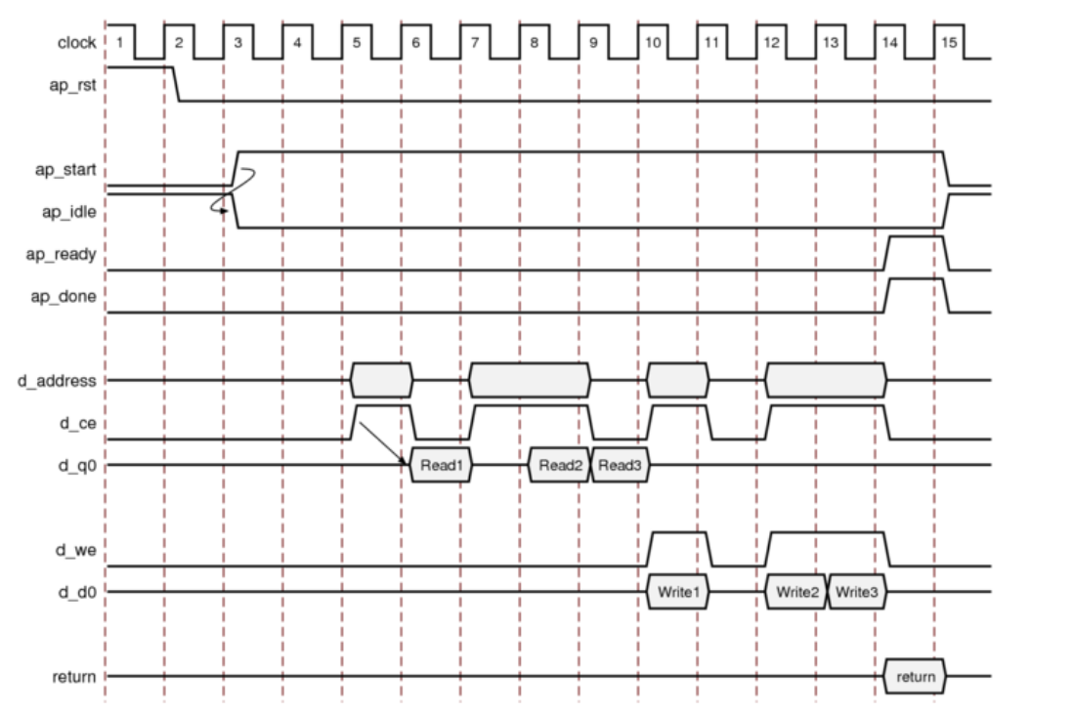
Memory IO Protocol (ap_memory)
After start, idle goes low and the RTL operates
When a read is required, an address is generated and CE asserted high
Data is available on data input port d_q0 in the next cycle
The read operations may be pipelined
When a write is required, the address and data are placed on the output ports
Both CE &WE are asserted high
Writes may be pipelined
Done will be asserted when the function is complete
There is no stall behavior initiated by a RAM interface

Slide 63
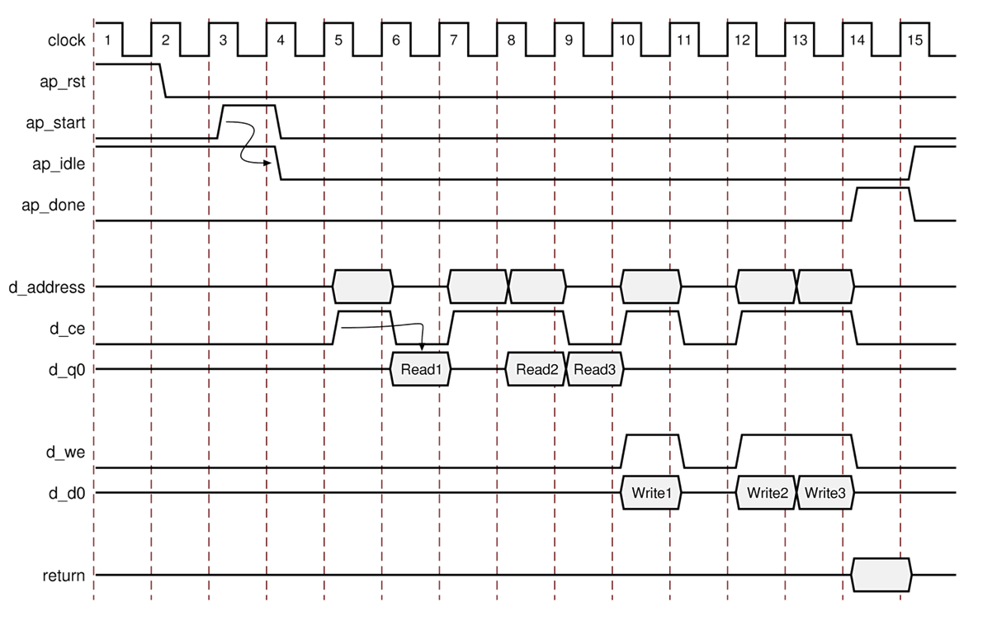
Memory IO Protocol (ap_memory)
After start, idle goes low and the RTL operates
When a read is required, an address is generated and CE asserted high
Data is available on data input port d_q0 in the next cycle
The read operations may be pipelined
When a write is required, the address and data are placed on the output ports
Both CE &WE are asserted high
Writes may be pipelined
Done will be asserted when the function is complete
There is no stall behavior initiated by a RAM interface

Slide 64
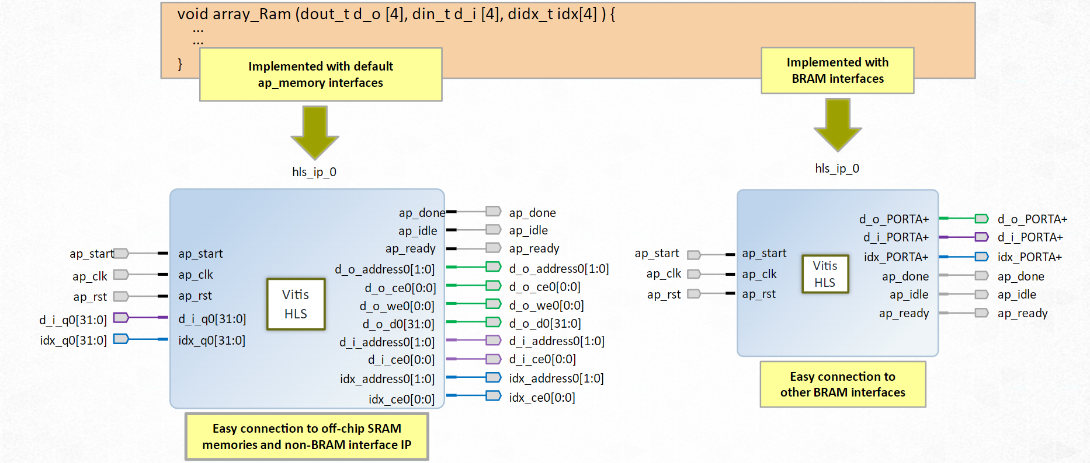
Block RAM(bram)
Block RAM interface is functionally identical to the ap_memory interface
The only difference is how the ports are implemented when the design s used in the IPI
An ap_memory interface is displayed as multiple and separate ports
Connect to off-chip SRAM and non-block RAM
A block RAM interface is displayed as a single grouped port
Connect to Xilinx block RAM

Slide 65
Block RAM(bram)
Block RAM interface is functionally identical to the ap_memory interface
The only difference is how the ports are implemented when the design s used in the IPI
An ap_memory interface is displayed as multiple and separate ports
Connect to off-chip SRAM and non-block RAM
A block RAM interface is displayed as a single grouped port
Connect to Xilinx block RAM

Slide 66
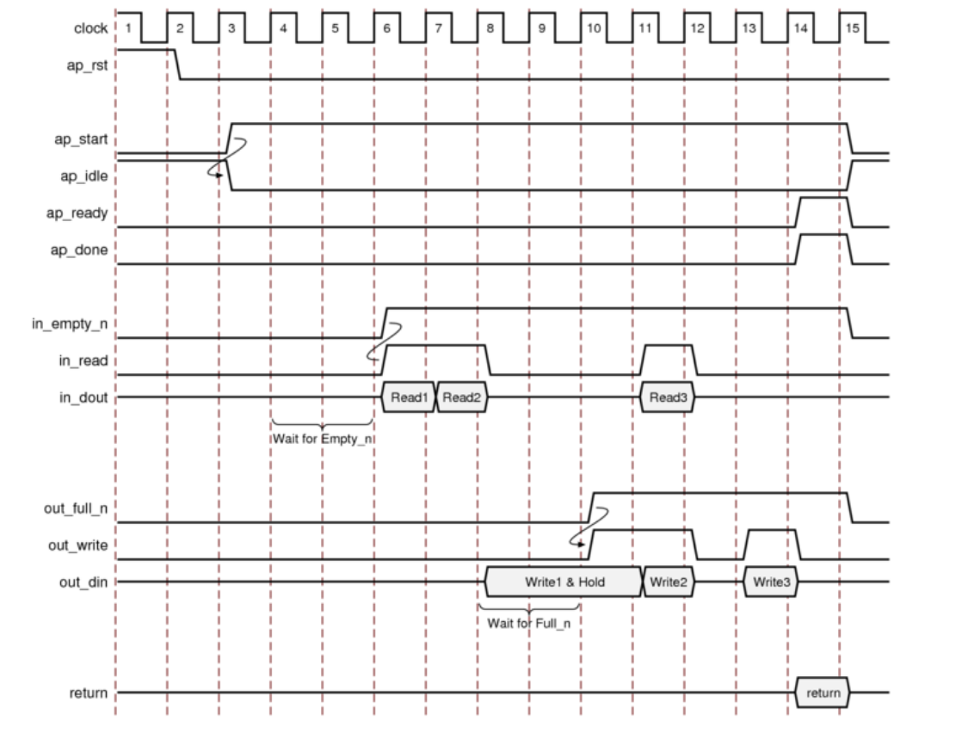
FIFO IO Protocol (ap_fifo, Read)
After Start is applied, the block begins normal operation
If the input port is ready to be read but the FIFO is empty as indicated by input port in_empty_n Low, the design stalls and waits for data to become available
When the FIFO contains data as indicated by input port in_empty_n High, an output acknowledges and the in_read is asserted High to indicate that the data was read in this cycle

Slide 67
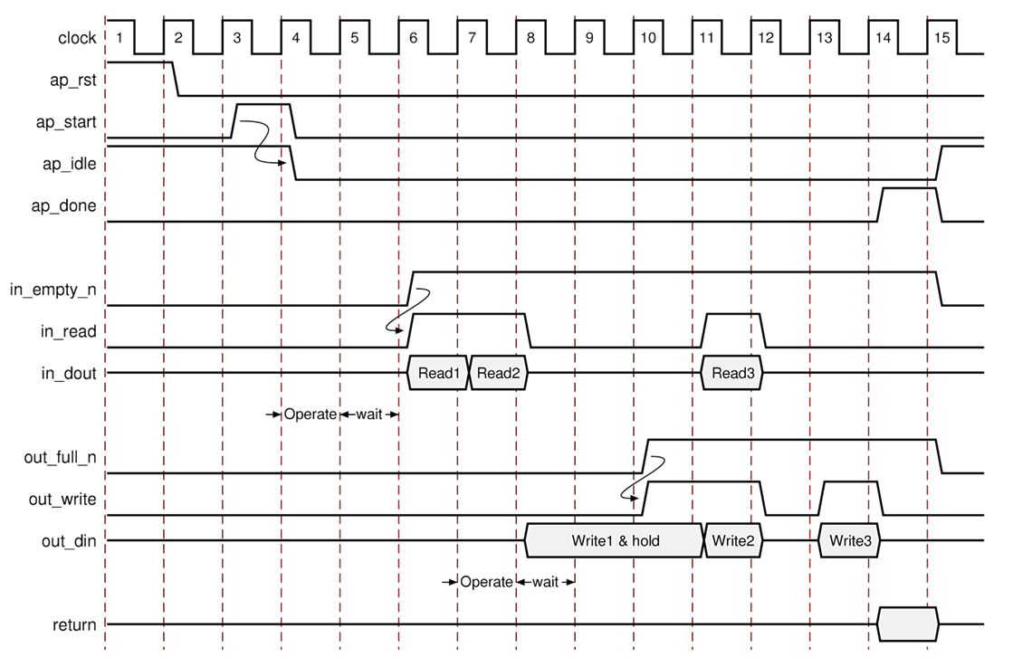
FIFO IO Protocol (ap_fifo, Read)
After Start is applied, the block begins normal operation
If the input port is ready to be read but the FIFO is empty as indicated by input port in_empty_n Low, the design stalls and waits for data to become available
When the FIFO contains data as indicated by input port in_empty_n High, an output acknowledges and the in_read is asserted High to indicate that the data was read in this cycle
After start, idle goes low and the RTL operates until a read is required
The RTL will stall (wait) until the empty_n is asserted high to indicate data is available
As soon as data is available, the fifo read port will go high
Reads will occur when required, so long as data is available (empty_n is high)
22- 67

Slide 68
FIFO IO Protocol (ap_fifo, Write)
If an output is ready to be written to but the FIFO is full as indicated by out_full_n Low, the data is placed on the output port but the design stalls and waits for the space to become available in the FIFO
When space becomes available in the FIFO as indicated by out_full_n High, the output acknowledges and the signal out_write is asserted to indicated that the output data is available
If the top-level function or the top-level loop is pipelined using the rewind option, the Vitis HLS tool creates an additional output port with the suffix_lwr

Slide 69
FIFO IO Protocol (ap_fifo, Write)
If an output is ready to be written to but the FIFO is full as indicated by out_full_n Low, the data is placed on the output port but the design stalls and waits for the space to become available in the FIFO
When space becomes available in the FIFO as indicated by out_full_n High, the output acknowledges and the signal out_write is asserted to indicated that the output data is available
If the top-level function or the top-level loop is pipelined using the rewind option, the Vitis HLS tool creates an additional output port with the suffix_lwr
When ready, data will be written to the output port
The RTL will then stall and hold the data until the FIFO is no longer full (full_n high)
As soon as data can written, write is asserted high
A write will occur when required if there is room in the fifo (full_n high)
Done will be asserted when the function is complete
22- 69

Slide 70
Interface Types
Multiple interface protocols
Every combination of C argument and port protocol is not supported
It may require a code modification to implement a specific IO protocol
Block Level Protocol
AXI4 Interfaces
No IO Protocol
Wire handshake protocols
Memory protocols : RAM
: FIFO
Block level protocols can be applied to the return port - but the port can be omitted and just the function name specified
22- 70
Bus protocols

Slide 71
Bus IO Protocol
Vivado HLS supports a Bus IO protocol
It is that of a generic bus
Not an industry standard
Can be used to communicate with a bus bridge
The Vivado HLS bus protocol is principally used to connect to adapters
The Bus IO protocol supports memcpy
The bus IO protocol supports the C function memcpy
This provides a high performance interface for bursting data in a DMA like fashion
The Bus IO protocol supports complex pointer arithmetic at the IO
Pointers at the IO can be synthesized to ap_fifo or ap_bus
If using ap_fifo, the accesses must be sequential
If pointer arithmetic is used, the port must use ap_bus
22- 71

Slide 72
Standard and Burst Mode
Standard Mode
Each access to the bus results in a request then a read or write operation
Multiple read or writes can be performed in a single transaction
Burst Mode
Use the memcpy command
Copies data between array & a pointer argument
The pointer argument can be a bus interface
This example uses a size of 4
This is more efficient for higher values
Multiple reads and writes in Standard Mode
Single read and write in Standard Mode
#include "bus.h"
void foo (int *d) {
static int acc = 0;
int i;
for (i=0;i<4;i++) {
acc += d[i];
d[i] = acc;
}
}
#include "bus.h"
void foo (int *d) {
static int acc = 0;
int i;
for (i=0;i<4;i++) {
acc += *(d+i);
*(d+i) = acc;
}
}
#include "bus.h"
void foo (int *d) {
static int acc = 0;
int i;
acc += d[i];
d[i] = acc;
}
#include "bus.h"
void foo (int *d) {
int buf1[4], buf2[4];
int i;
memcpy(buf1,d,4*sizeof(int));
for (i=0;i<4;i++) {
buf2[i] = buf1[3-i];
}
memcpy(d,buf2,4*sizeof(int));
}
22- 72

Slide 73
Bus IO Protocol: Ports Generated
Bus request then access protocol
The protocol will request a read/write bus access
Then read or write data in single or burst mode
foo
d_dataout[31:0]
d_datain[31:0]
d_req_write
d_rsp_read
#include “foo.h"
void foo (int *d) {
…
}
d_req_full_n
d_req_din
d_rsp_empty_n
d_rsp_dout
d_address[31:0]
d_size[31:0]
Input Ports | Description
d_datain | Input data.
d_req_full_n | Active low signal indicates the bus bridge is full. The design will stall, waiting to write.
d_rsp_empty_n | Active low signal indicates the bus bridge is empty and can accept data.
Output Ports | Description
d_dataout | Output data.
d_req_write | Asserted to initiate a bus access.
d_req_din | Asserted if the bus access is to write. Remains low if the access it to read.
d_rsp_read | Asserted to start a bus read (completes a bus access request and starts reading data)
d_address | Offset for the base address.
d_size | Indicates the burst (read or write) size.
Standard Mode: The address port gives the index address e.g. *(d+i), addr = value of “i”
22- 73

Slide 74
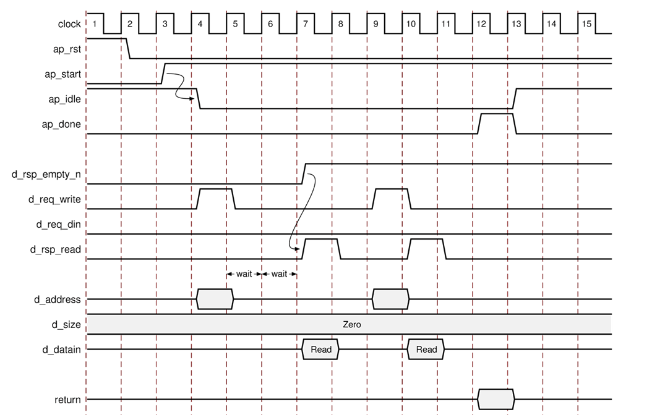
Bus IO Protocol (Standard, Read)
void foo (int *d) {
static int acc = 0;
int i;
for (i=0;i<4;i++) {
acc += d[i+1];
d[i] = acc;
}
}
After start, idle goes low and the RTL operates until a read is required
A req_write high with req_din low indicates a read request
A read address is supplied: value is the pointer index value
The RTL will stall (wait) until the empty_n is asserted high to indicate data is available
As soon as data is available, rsp_read will go high
Reads will occur when required, so long as data is available (empty_n is high)
22- 74

Slide 75
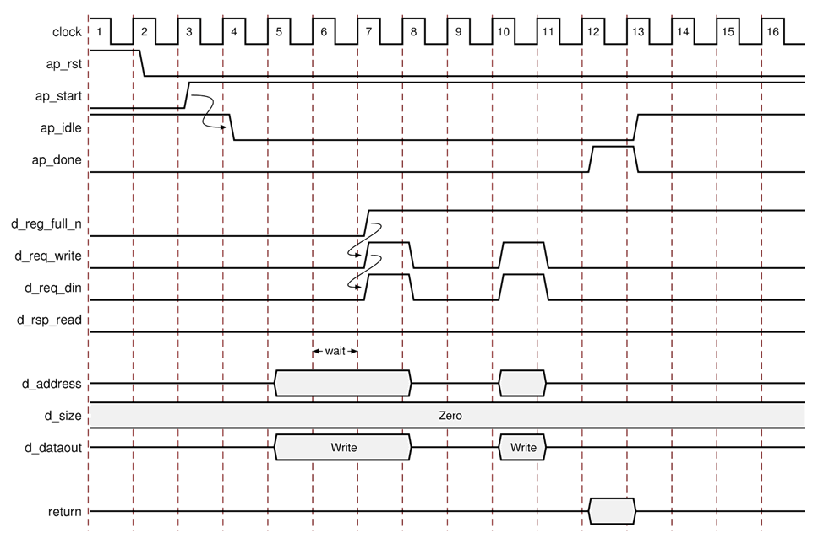
Bus IO Protocol (Standard, Write)
void foo (int *d) {
static int acc = 0;
int i;
for (i=0;i<4;i++) {
acc += d[i+1];
d[i] = acc;
}
}
After start, idle goes low and the RTL operates until a write is required
When a write is required, data and address are applied
The RTL will stall (wait) until the full_n is asserted high to indicate space is available
As soon as data is available, rsp_write and req-din will go high
A req_write high with req_din high indicates a write request
There is no acknowledge for writes in this interace
Write will occur when required, so long as data is available (full_n is high)
22- 75

Slide 76
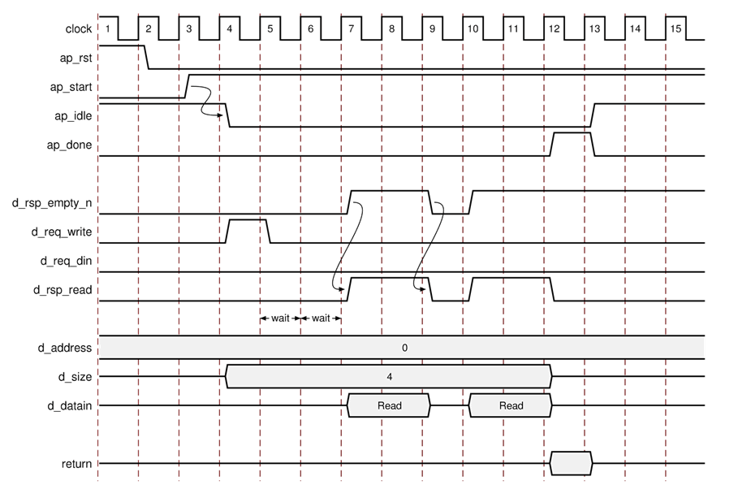
Bus IO Protocol (Burst, Read)
void foo (int *d) {
int buf1[4], buf2[4];
int i;
memcpy(buf1,d,4*sizeof(int));
for (i=0;i<4;i++) {
buf2[i] = buf1[3-i];
}
memcpy(d,buf2,4*sizeof(int));
}
Similar to a Standard Mode
This example uses a burst=4
The base address is zero
The burst size is placed on port size
All reads are done consecutively
The empty_n signal will stall the RTL until data is available

Slide 77
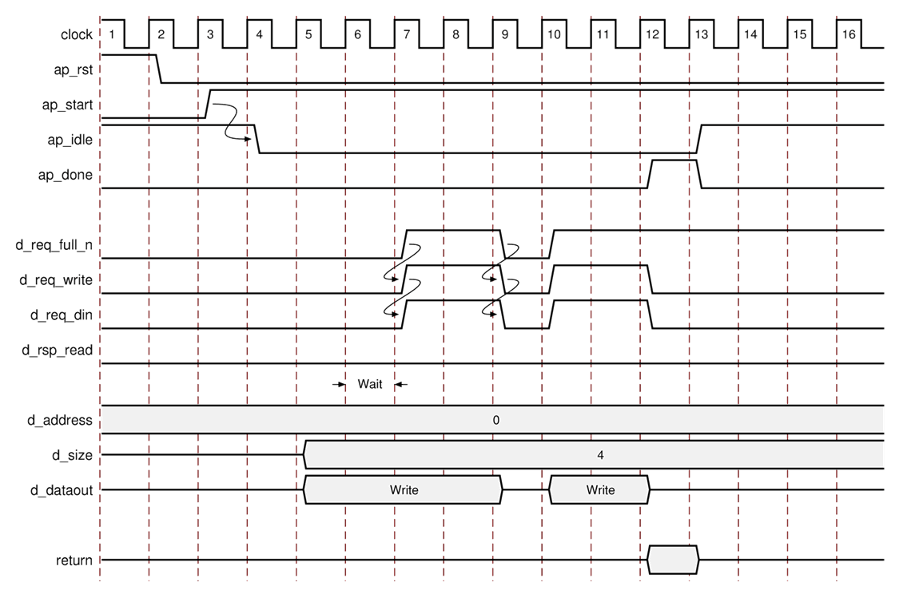
Bus IO Protocol (Burst, Write)
void foo (int *d) {
int buf1[4], buf2[4];
int i;
memcpy(buf1,d,4*sizeof(int));
for (i=0;i<4;i++) {
buf2[i] = buf1[3-i];
}
memcpy(d,buf2,4*sizeof(int));
}
Similar to a Standard Mode
This example uses a burst=4
The base address is zero
The burst size is placed on port size
All writes are done consecutively
The full_n signal will stall the RTL until data is available
22- 77

Slide 78
Summary

Slide 79
Summary
Vitis HLS has four types of IO
Data ports created by the original C function arguments
IO protocol signals added at the Block-Level
IO protocol signals added at the Port-Level
IO protocol signals added externally as IP Interfaces
Block Level protocols provide default handshake
Block Level handshakes are added to the RTL design
Enables system level control & sequencing
Port Level Protocols provide wide support for all standard IO protocols
The protocol is dependent on the C variable type

Slide 80
Summary
Vitis HLS has four types of IO
Data ports created by the original C function arguments
IO protocol signals added at the Block-Level
IO protocol signals added at the Port-Level
IO protocol signals added externally as IP Interfaces
Block Level protocols provide default handshake
Block Level handshakes are added to the RTL design
Enables system level control & sequencing
Port Level Protocols provide wide support for all standard IO protocols
The protocol is dependent on the C variable type

